Slide 1
A First Book of ANSI C Fourth Edition
Chapter 8
Arrays

Slide 2
Objectives
One-Dimensional Arrays
Array Initialization
Arrays as Function Arguments
Case Study: Computing Averages and Standard Deviations
Two-Dimensional Arrays
Common Programming and Compiler Errors

Slide 3
Introduction
Atomic variable: variable whose value cannot be further subdivided into a built-in data type
Also called a scalar variable
Data structure (aggregate data type): data type with two main characteristics
Its values can be decomposed into individual data elements, each of which is either atomic or another data structure
It provides an access scheme for locating individual data elements within the data structure

Slide 4
Introduction (continued)
One of the simplest data structures, called an array, is used to store and process a set of values, all of the same data type, that forms a logical group

Slide 5
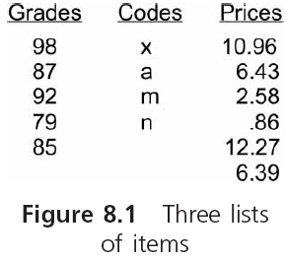
Introduction (continued)

Slide 6
One-Dimensional Arrays
A one-dimensional array, also called a single-dimensional array and a single-subscript array, is a list of values of the same data type that is stored using a single group name

Slide 7
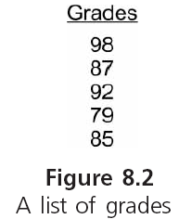
One-Dimensional Arrays (continued)

Slide 8
One-Dimensional Arrays (continued)
To create a one-dimensional array:
#define NUMELS 5
int grades[NUMELS];
In C, the starting index value for all arrays is 0
Each item in an array is called an element or component of the array
Any element can be accessed by giving the name of the array and the element’s position
The position is the element’s index or subscript
Each element is called an indexed variable or a subscripted variable

Slide 9
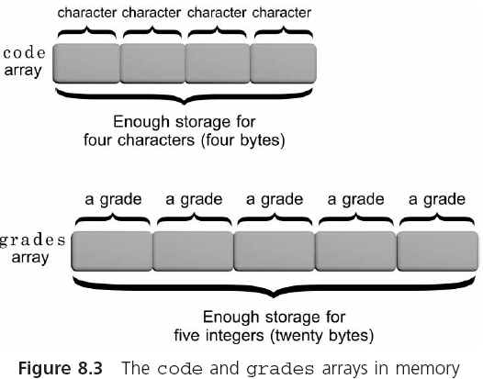
One-Dimensional Arrays (continued)

Slide 10
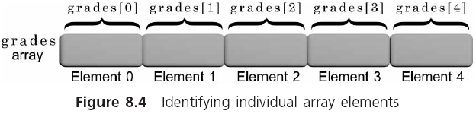
One-Dimensional Arrays (continued)

Slide 11
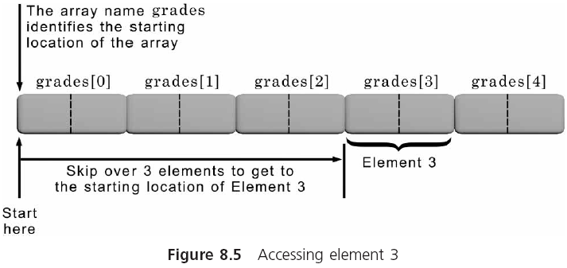
One-Dimensional Arrays (continued)

Slide 12
One-Dimensional Arrays (continued)
Subscripted variables can be used anywhere scalar variables are valid
grades[0] = 98;
grades[1] = grades[0] - 11;
Any expression that evaluates an integer may be used as a subscript
#define NUMELS 5
total = 0; /* initialize total to zero */
for (i = 0; i < NUMELS; i++)
total = total + grades[i]; /* add a grade */

Slide 13
Input and Output of Array Values
Individual array elements can be assigned values using individual assignment statements or, interactively, using the scanf() function
#define NUMELS 5
for(i = 0; i < NUMELS; i++)
{
printf("Enter a grade: ");
scanf("%d", &grades[i]);
}
Be careful: C does not check the value of the index being used (called a bounds check)

Slide 14
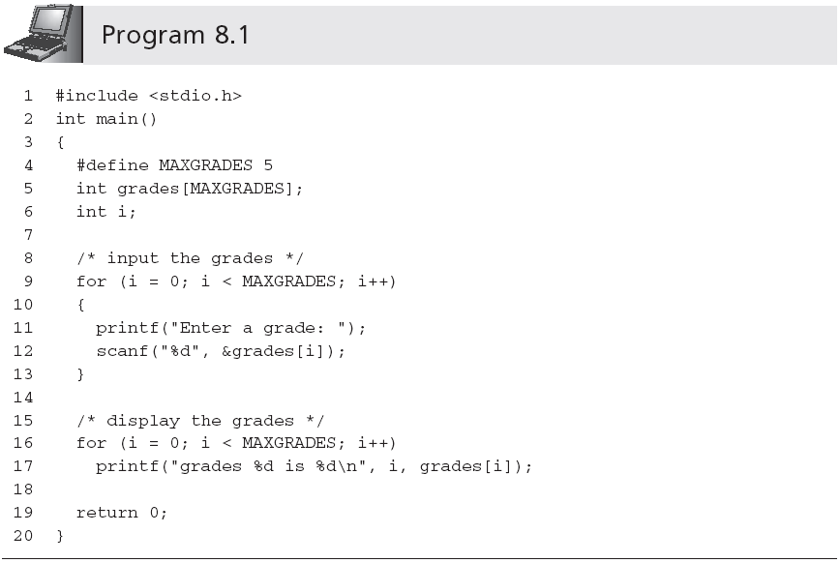
Input and Output of Array Values (continued)
Sample output:
Enter a grade: 85
Enter a grade: 90
Enter a grade: 78
Enter a grade: 75
Enter a grade: 92
grades 0 is 85
grades 1 is 90
grades 2 is 78
grades 3 is 75
grades 4 is 92

Slide 15
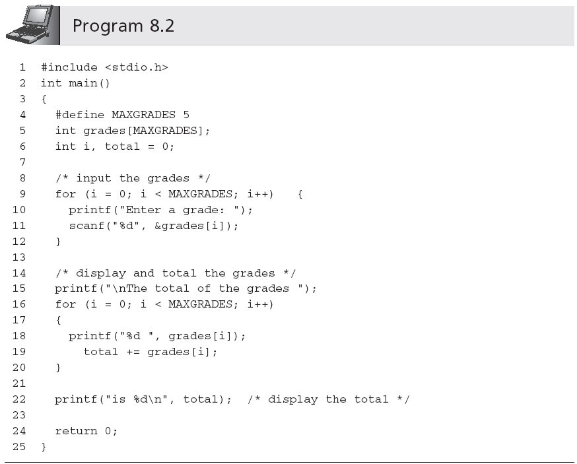
Input and Output of Array Values (continued)
Statement is outside of the second for loop; total is displayed only once, after all values have been added

Slide 16
Array Initialization
The individual elements of all global and static arrays (local or global) are, by default, set to 0 at compilation time
The values within auto local arrays are undefined
Examples of initializations:
int grades[5] = {98, 87, 92, 79, 85};
double length[7] = {8.8, 6.4, 4.9, 11.2};
char codes[6] = {'s', 'a', 'm', 'p', 'l', e'};
char codes[] = {'s', 'a', 'm', 'p', 'l', 'e'};
char codes[] = "sample"; /* size is 7 */

Slide 17
Array Initialization (continued)
1 #define SIZE1 20
2 #define SIZE2 25
3 #define SIZE3 15
4
5 int gallons[SIZE1]; /* a global array */
6 static int dist[SIZE2]; /* a static global array */
7
8 int main()
9 {
10 int miles[SIZE3]; /* an auto local array */
11 static int course[SIZE3]; /* static local array */
12 .
13 .
14 return 0;
15 }

Slide 18
Array Initialization (continued)
The NULL character, which is the escape sequence \0, is automatically appended to all strings by the C compiler

Slide 19
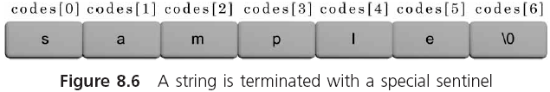
Array Initialization (continued)

Slide 20
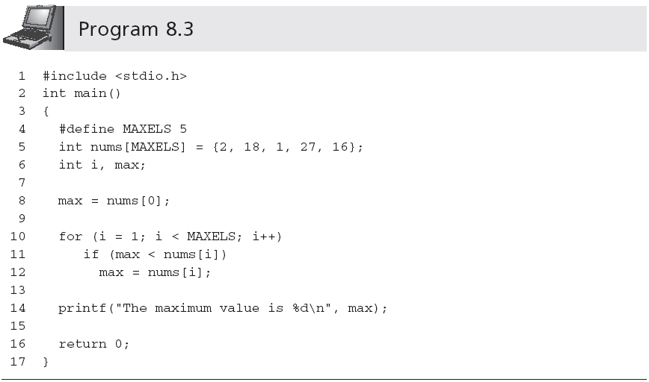
Array Initialization (continued)

Slide 21
Arrays as Function Arguments
Individual array elements are passed to a function by including them as subscripted variables in the function call argument list
findMin(grades[2], grades[6]);
Pass by value
When passing a complete array to a function, the called function receives access to the actual array, rather than a copy of the values in the array
findMax(grades);
Pass by reference

Slide 22
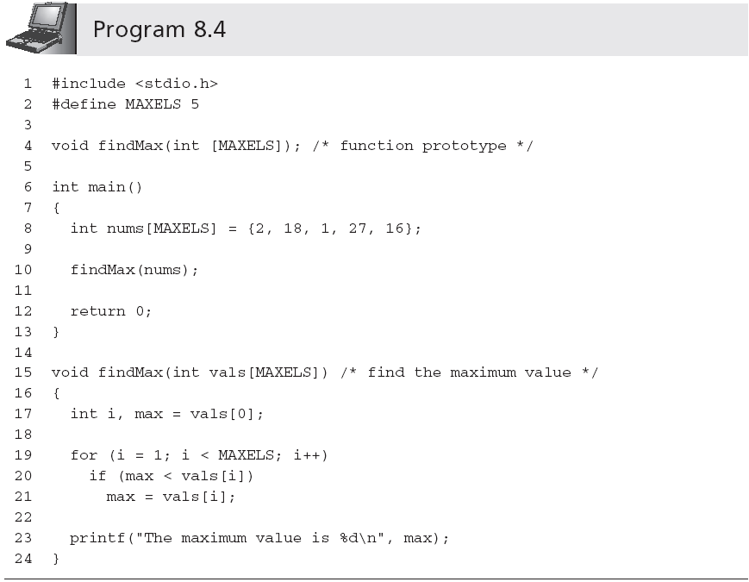
Arrays as Function Arguments (continued)
Size can be omitted

Slide 23
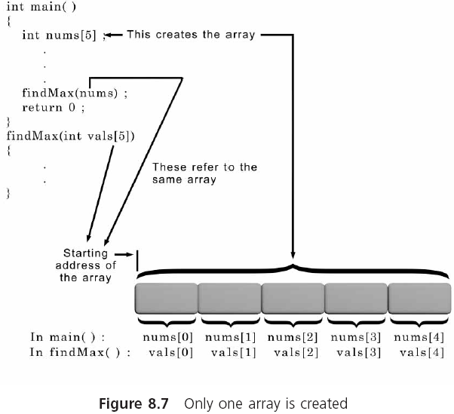
Arrays as Function Arguments (continued)

Slide 24
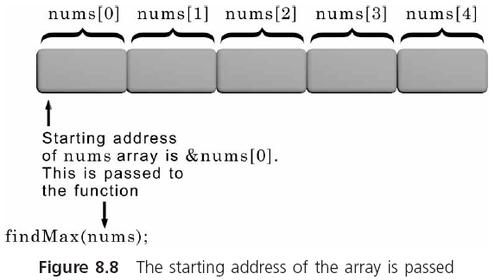
Arrays as Function Arguments (continued)

Slide 25
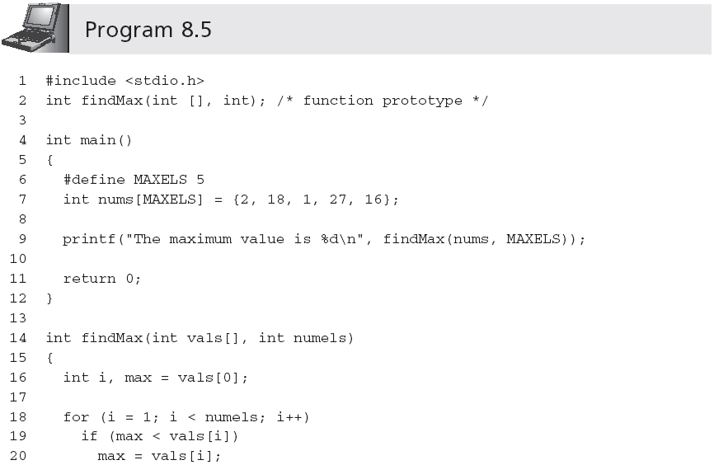
Arrays as Function Arguments (continued)

Slide 26
Case Study: Computing Averages and Standard Deviations
Two statistical functions are created to determine the average and standard deviation, respectively, of an array of numbers

Slide 27
Requirements Specification
Need two functions
Determine the average…
Determine the standard deviation…
…of a list of integer numbers
Each function must accept the numbers as an array and return the calculated values to the calling function
We now apply the top-down development procedure to developing the required functions

Slide 28
Analyze the Problem
Determine the input items: list of integer numbers
Determine the desired outputs: (1) average, and (2) standard deviation
List the algorithms relating the inputs and outputs:
Average Function: Calculate the average by adding the grades and dividing by the # of added grades
Standard Deviation Function:
Subtract the average from each individual grade. Each number in the new set is called a deviation.
Square each deviation found in Step 1.
Add the squared deviations and divide the sum by the number of deviations.
The square root of the number found in Step 3 is the standard deviation.

Slide 29
Select an Overall Solution
Problem-Solver Algorithm is adapted:
Initialize an array of integers
Call the average function
Call the standard deviation function
Display the returned value of the average function
Display the returned value of the standard deviation function

Slide 30
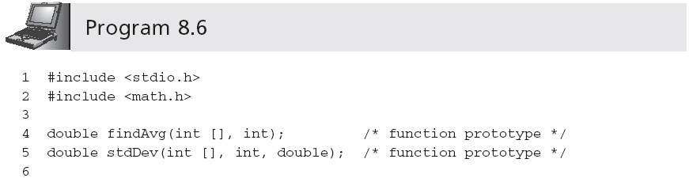
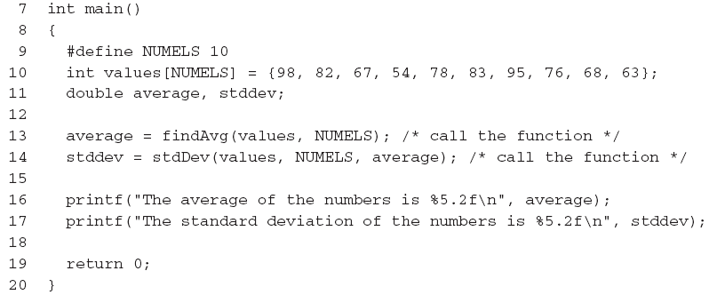
Write the Functions

Slide 31
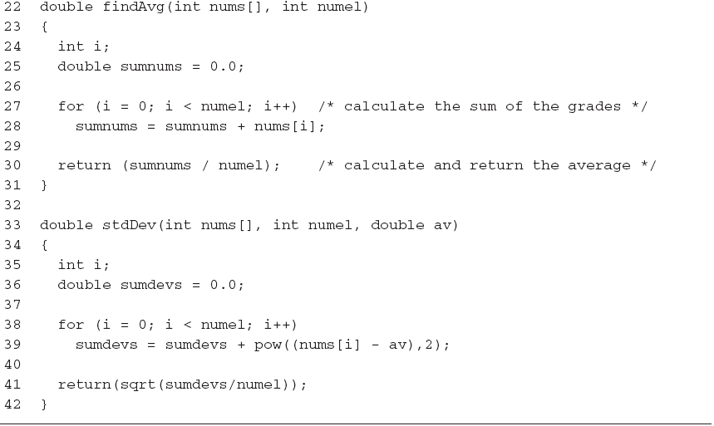
Write the Functions (continued)

Slide 32
Test and Debug the Functions
Write a main() program unit to call the function and display the returned results (see Program 8.6)
A test run using Program 8.6 produced the following display:
The average of the numbers is 76.40
The standard deviation of the numbers is 13.15
Testing is not complete without verifying the calculation at the boundary points
Checking the calculation with all of the same values, such as all 0s and all 100s
Use five 0s and five 100s

Slide 33
Two-Dimensional Arrays
A two-dimensional array, or table, consists of both rows and columns of elements
int val[3][4];

Slide 34
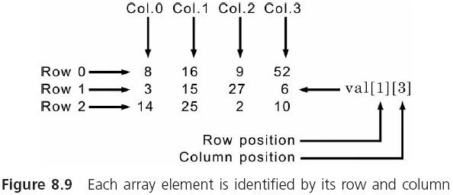
Two-Dimensional Arrays (continued)

Slide 35
Two-Dimensional Arrays (continued)
Initialization:
#define NUMROWS 3
#define NUMCOLS 4
int val[NUMROWS][NUMCOLS] = { {8,16,9,52},
{3,15,27,6},
{14,25,2,10} };
The inner braces can be omitted:
int val[NUMROWS][NUMCOLS] = {8,16,9,52,3,15,27, 6,14,25,2,10};
Initialization is done in row order

Slide 36
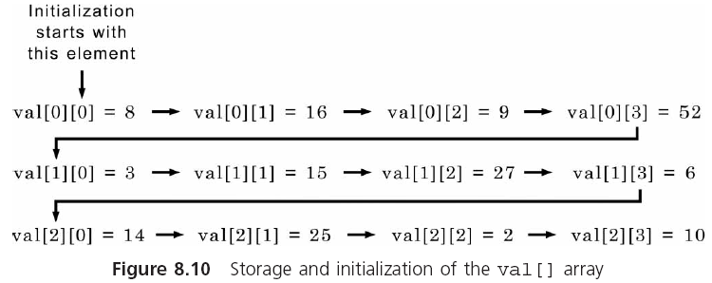
Two-Dimensional Arrays (continued)

Slide 37
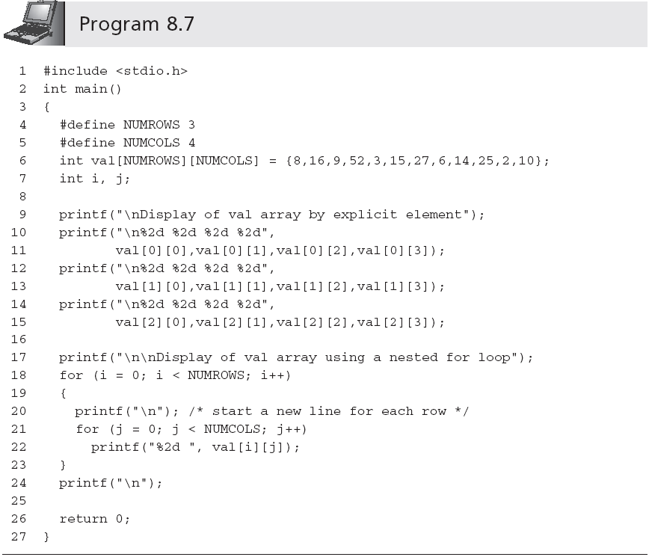
Two-Dimensional Arrays (continued)

Slide 38
Two-Dimensional Arrays (continued)
The display produced by Program 8.7 is
Display of val array by explicit element
8 16 9 52
3 15 27 6
14 25 2 10
Display of val array using a nested for loop
8 16 9 52
3 15 27 6
14 25 2 10

Slide 39
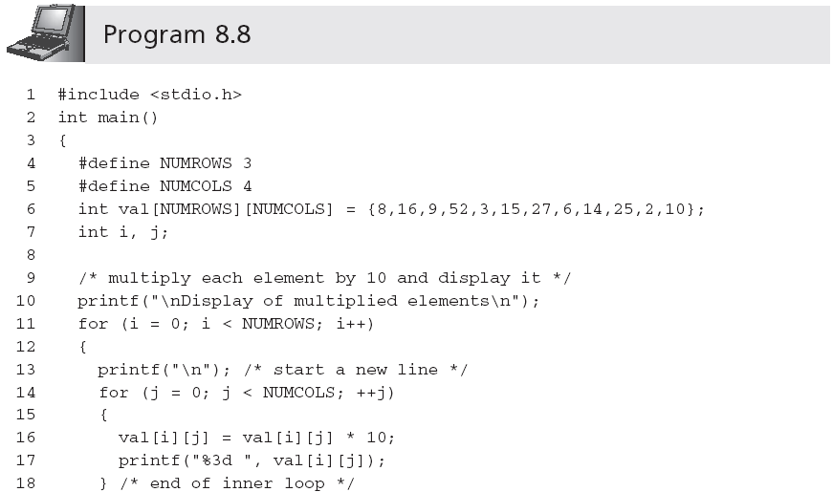
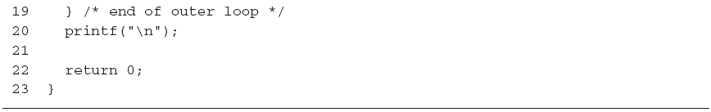
Two-Dimensional Arrays (continued)

Slide 40
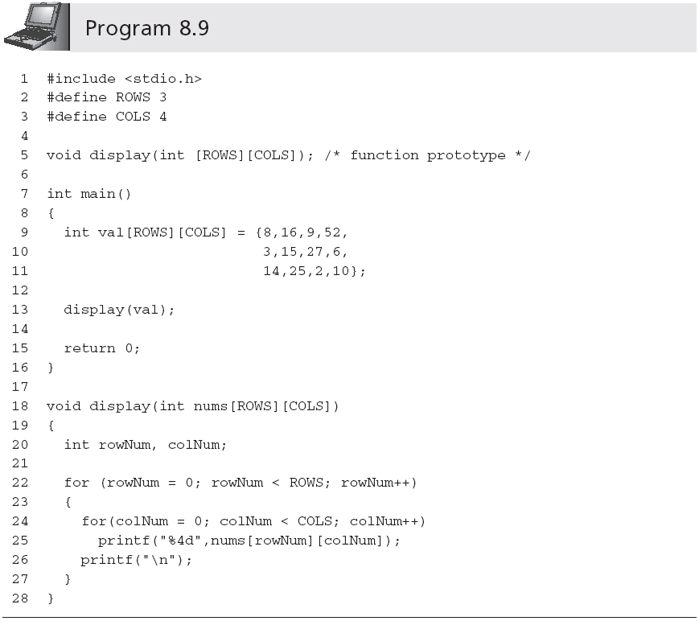
Two-Dimensional Arrays (continued)
Row size can be omitted

Slide 41
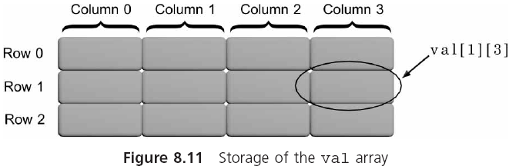
Two-Dimensional Arrays (continued)

Slide 42
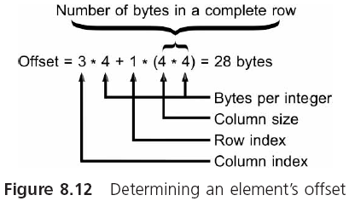
Two-Dimensional Arrays (continued)

Slide 43
Internal Array Element Location Algorithm
Each element in an array is reached by adding an offset to the starting address of the array
Address element i = starting array address + offset
For single-dimensional arrays:
Offset = i * the size of an individual element
For two-dimensional arrays:
Offset = column index value * the size of an individual element + row index value * # of bytes in a complete row
# of bytes in a complete row = maximum column specification * the size of an individual element

Slide 44
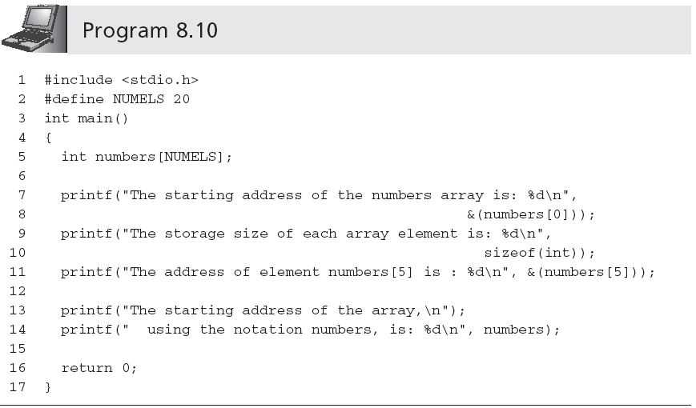
Internal Array Element Location Algorithm (continued)

Slide 45
Larger Dimensional Arrays
A three-dimensional array can be viewed as a book of data tables (the third subscript is called the rank)
int response[4][10][6];
A four-dimensional array can be represented as a shelf of books where the fourth dimension is used to declare a desired book on the shelf
A five-dimensional array can be viewed as a bookcase filled with books where the fifth dimension refers to a selected shelf in the bookcase
Arrays of three, four, five, six, or more dimensions can be viewed as mathematical n-tuples

Slide 46
Common Programming Errors
Forgetting to declare the array
Using a subscript that references a nonexistent array element
Not using a large enough conditional value in a for loop counter to cycle through all the array elements
Forgetting to initialize the array

Slide 47
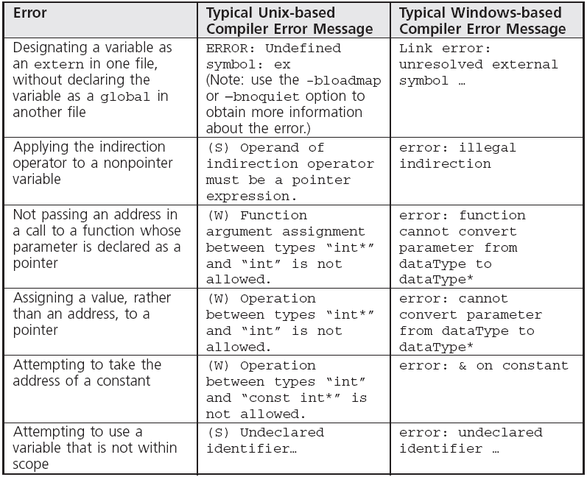
Common Compiler Errors

Slide 48
Summary
A single-dimensional array is a data structure that can store a list of values of the same data type
Elements are stored in contiguous locations
Referenced using the array name and a subscript
Single-dimensional arrays may be initialized when they are declared
Single-dimensional arrays are passed to a function by passing the name of the array as an argument

Slide 49
Summary (continued)
A two-dimensional array is declared by listing both a row and a column size with the data type and name of the array
Two-dimensional arrays may be initialized when they are declared
Two-dimensional arrays are passed to a function by passing the name of the array as an argument

